Slide 1
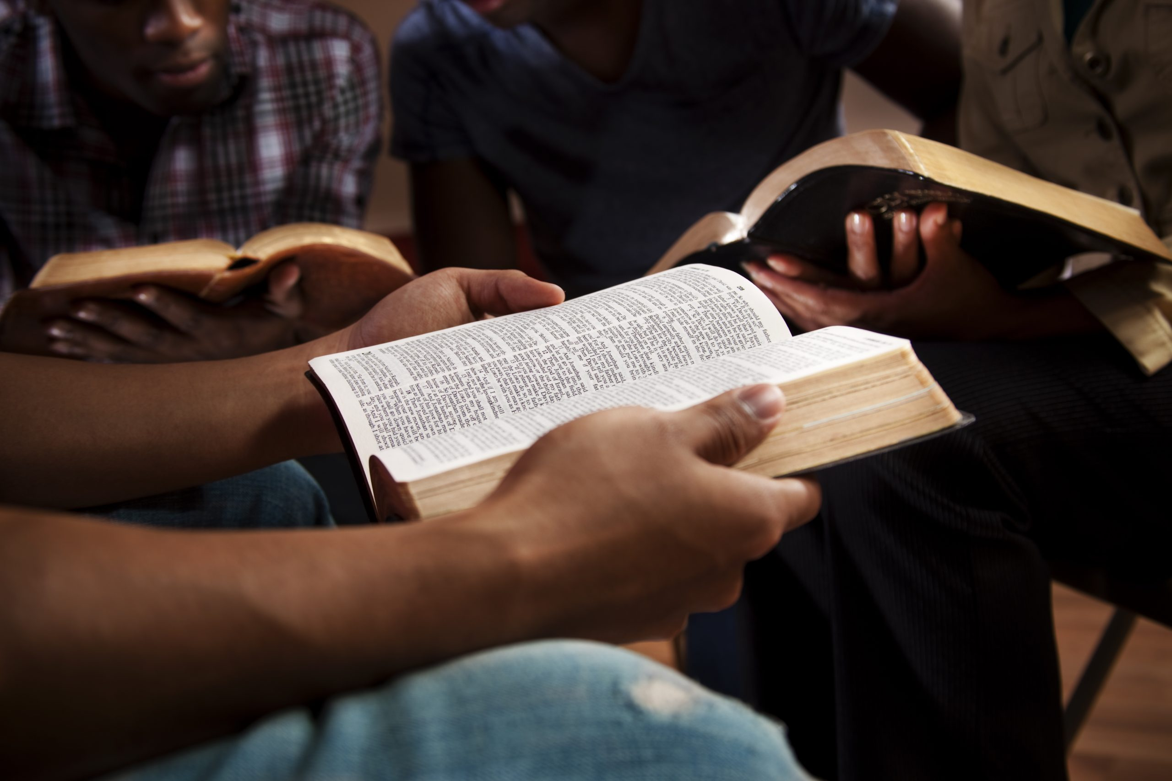
Young Adult Bible Class 8/14/22
Where Your Heart Has A Home

Slide 2
….For Your Eye’s Only….
Excluding worship service and Bible Class, how often do you read the Bible?
Have you read the all of the New Testament?
Have you read all of the Old Testament?
Where Your Heart Has A Home

Slide 3
A Few Facts About The Bible
Best Sell ever year!
85% to 90% of households have a Bible!
75% of Christians believe that the Bible is the word of God!
Where Your Heart Has A Home

Slide 4
Is It Possible That This Brother is Right?
https://www.youtube.com/watch?v=zygIMskezOs
Where Your Heart Has A Home

Slide 5
Discussion
How would you summarize this video?
Is this Brother right about his assessment? Explain.
At this stage in your life, what got you here?
(Church, Bible Class, Bible Reading)
Where Your Heart Has A Home

Slide 6
A Few Reasons To Be A Bible Reader
2 Peter 1:3 It supplies us all we need for life and godliness
John 20:30-31 Builds our belief in Jesus (Faith)
Acts 17:30 God no longer overlooks ignorance
John 12:48 You will be judged by the Word of God!
Where Your Heart Has A Home

Slide 7
What Are You Going To Do?
Where Your Heart Has A Home

