Slide 1
Fearful Distractions
Mark:17-27

Slide 2
WHAT ARE YOU AFRAID OF?
Maybe I’m wrong, but I think we’re afraid of living a life of full faith. I think we hold back because full faith terrifies us.

Slide 3
Mark:17-22
¹⁷ As Jesus started on his way, a man ran up to him and fell on his knees before him. “Good teacher,” he asked, “what must I do to inherit eternal life?”¹⁸ “Why do you call me good?” Jesus answered. “No one is good—except God alone. ¹⁹ You know the commandments: ‘You shall not murder, you shall not commit adultery, you shall not steal, you shall not give false testimony, you shall not defraud, honor your father and mother.”

Slide 4
Mark:17-22 cont.
²⁰ “Teacher,” he declared, “all these I have kept since I was a boy.”²¹ Jesus looked at him and loved him. “One thing you lack,” he said. “Go, sell everything you have and give to the poor, and you will have treasure in heaven. Then come, follow me.”²² At this the man’s face fell. He went away sad, because he had great wealth.

Slide 5
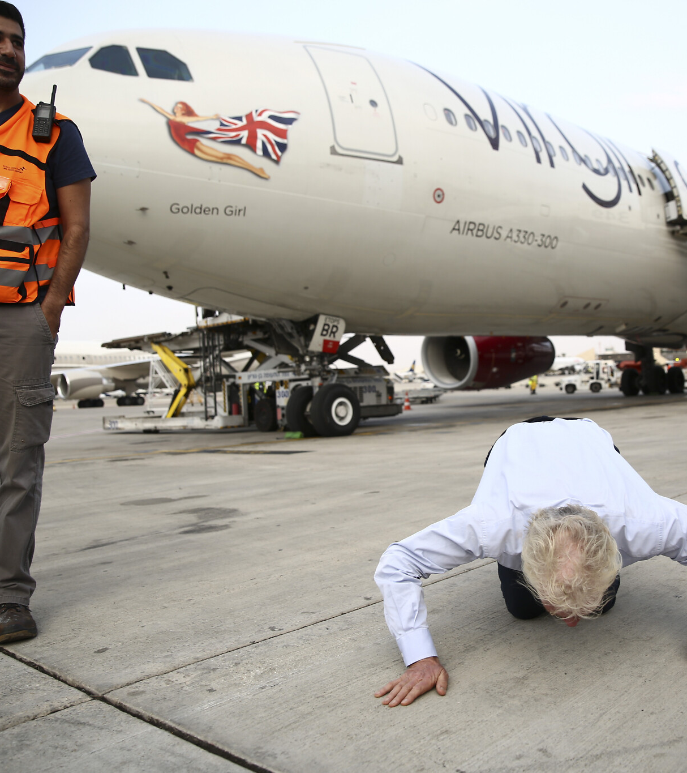
THE GROUND IS SURE
We like the ground because it is safe.

Slide 6
LINE 1: I BELIEVE IN GOD AND THE GOSPEL OF CHRIST ENOUGH TO BENEFIT FROM IT
¹⁷ Jesus asked, “Were not all ten cleansed? Where are the other nine? ¹⁸ Has no one returned to give praise to God except this foreigner?”
-LUKE 17:17,18

Slide 7
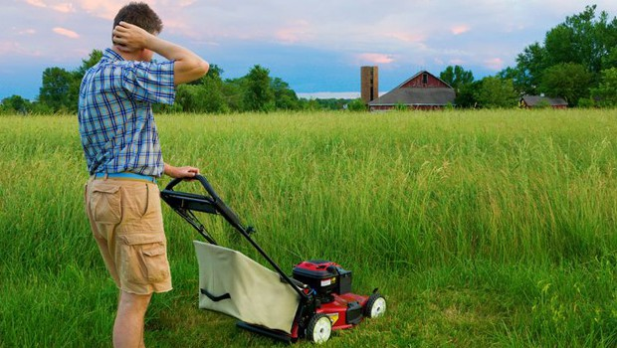
LINE 2: I BELIEVE IN GOD AND THE GOSPEL OF CHRIST ENOUGH TO CONTRIBUTE COMFORTABLY
We are happy to follow along behind God even if it costs a great deal, so long as it doesn’t cost too much.

Slide 8
WHATS HOLDING YOU BACK?
Fear of responsibility
Fear of failure
Fear of reputation or perception

Slide 9
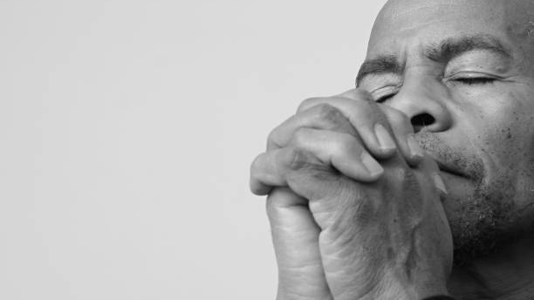
LINE 3: I BELIEVE IN GOD AND THE GOSPEL OF CHRIST FULLY
Do you fully believe in God and the Gospel of Christ fully?

Slide 10
ARE YOU READY?
What lies on the other side of your faith is so much greater than the sum of your fears.

